Slide 1
Ocular Disease Recognition through Deep Learning Architectures
Course:499B Group 4B
Md Sazid Ahmed Tonmoy 1911498042
Hawlader Md Hadiuzzaman Reaz 1821940042
Submitted to:
Mr. Abu Obaidah

Slide 2
Introduction
Various ocular diseases are capable of causing permanent and irreversible damage to the patient’s vision.
Ocular diseases are primarily diagnosed using color fundus photography.
In recent times, deep learning-based neural network models have shown promising results in medical image classification and object detection.
In recent times, deep learning-based neural network models have shown promising results in medical image classification and object detection. But Binary Classification can produce higher accuracy.
VGG-19, Resnet50, and Mobilenetv2 models are used for transfer learning approach to predict disease or not.

Slide 3
Abstract
Four deep learning-based models for pinpointing ocular diseases are presented in this work (Normal VS Cataract, Normal VS Glaucoma, Normal VS Myopia, Normal VS Hypertensive).
For this work, we used the ODIR dataset, which consists of 5000 fundus images. we took 3404 fundus images divided into 5 distinct groups.
To train cutting-edge image classification algorithms including Resnet-50, MobileNetV2, and VGG-19.

Slide 4
Paper review
Nowadays eye disease is a serious problem and many trials are being conducted on this disease. Many people are using many techniques to detect eye disease to cure it. Some authors mention their technique in their papers.
Sakib and his team used the VGG19 model and a fundus copy image to compare normal patients to cataract, pathological myopia, and glaucoma patients. [1]
Lorick Jain and his team mentioned that their goal was to develop a system to classify retinal fundal images as diseased or healthy, and they developed a system called LCDnet by using CNN.[2]
Nadim and his team has developed four neural network based ocular diseases. Those are Resnet34, EfficientNet, mobileNetV2 and VGG16, and they worked with seven diseases: Diabetes, Glaucoma, cataract, Myopia,hypertension, age-related macular disease and other abnormalities.[3]
Author 1 | Accuracy
Normal VS Myopia | 98.13%
Normal VS Cataract | 94.03%
Normal VS Glaucoma | 90.94%
Author 2 | Accuracy
Diseased or Healthy | 96.5%
Author 3 | Accuracy
Resnet34 | 97.23%
EffcientNet | 90.85%
MobileNetV2 | 94.32%
VGG16 | 93.82

Slide 5
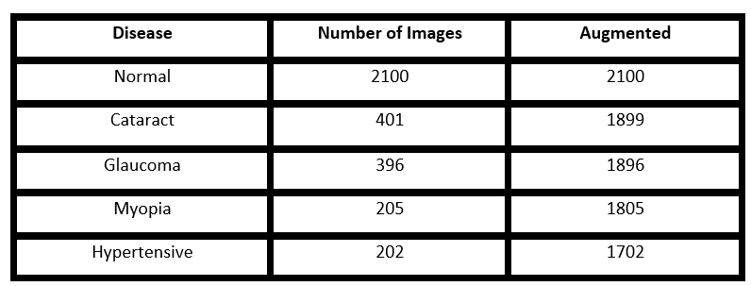
Dataset
The 5000 color fundus images in this dataset
All of the photographs for this project were scaled to 224* 224.
The full ODIR dataset was not used for this research. Normal, cataract, glaucoma, myopia, and hypertension related images are being used.
To remove imbalance, normal images are taken according to the disease’s image number to train the model.
For VGG19 and Resnet50, The dataset was splitted into 90% and 10% ratio for training and testing.
For MobilenetV2, the dataset was split into 70%, 20%, and 10% ratios for training, validation, and testing.
For Mobilenetv2, the accuracy was too low. That is why the dataset was augmented for better results.

Slide 6
Methodology
There are various types of images of ocular diseases.
We chose cataracts, glaucoma, pathological myopia, and hypertensive retinopathy to work with.
For each model (VGG19, Resnet50, Mobilenetv2), we tested Normal vs. Cataract, Normal vs. Glaucoma, Normal vs. Myopia, and Normal vs. Hypertension.
We take 100 epoch for every model. We resize every images 224*224.
We also did use some function for time reduction. EarlyStopping class stops training when a monitored metric has stopped improving.
ReduceLROnPlateau class reduces learning rate when a metric has stopped improving.

Slide 7
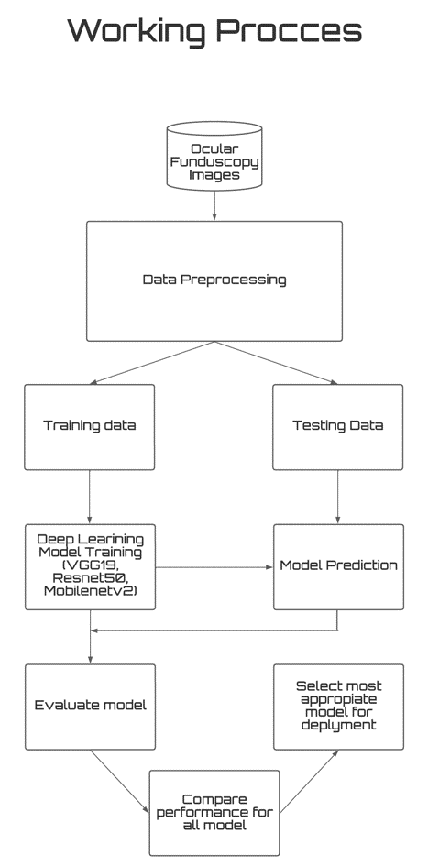
Working Process

Slide 8
Tools
Kaggle
Google Colab
Jupyter Notepad
Streamlit

Slide 9
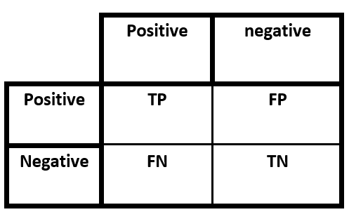
Evaluation of model
The classification model’s accuracy in classifying instances into distinct groups is summarized in a table called the confusion matrix. The model’s anticipated label is on one axis of the confusion matrix, while the actual label is on the other.
TP = True Positive (The total number of images that are correctly detected to be positive) FP = False Positive (The total number of images that are predicted to be positive but actually are negative) TN = True Negative (The number of images that are accurately predicted to be negative) FN = False Negative (The number of images that are incorrectly predicted to be negative)

Slide 10
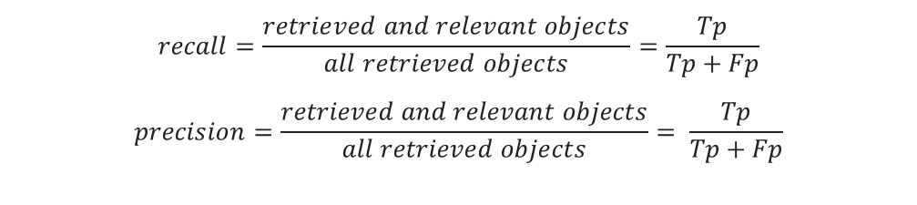
Evaluation of model
Precision and recall are two metrics used to evaluate classification and retrieval systems’ performance. Precision is the percentage of relevant occurrences among all retrieved examples. Recall, also known as sensitivity, is the percentage of recovered instances among all appropriate models. In a perfect classifier, precision and recall are both one.
$$recall=\frac{retrieved and relevant objects}{all retrieved objects}=\frac{Tp}{Tp+Fp}$$
$$precision=\frac{retrieved and relevant objects}{all retrieved objects}= \frac{Tp}{Tp+Fp}$$

Slide 11
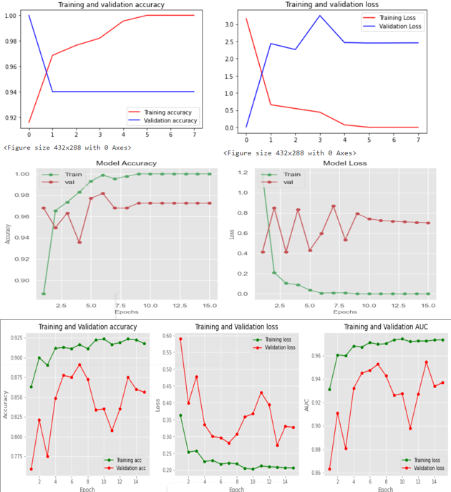
Training and Validation Graph For Normal VS Cataract
Upper One: Resnet50, Middle One: VGG19, Lower One: MobilenetV2

Slide 12
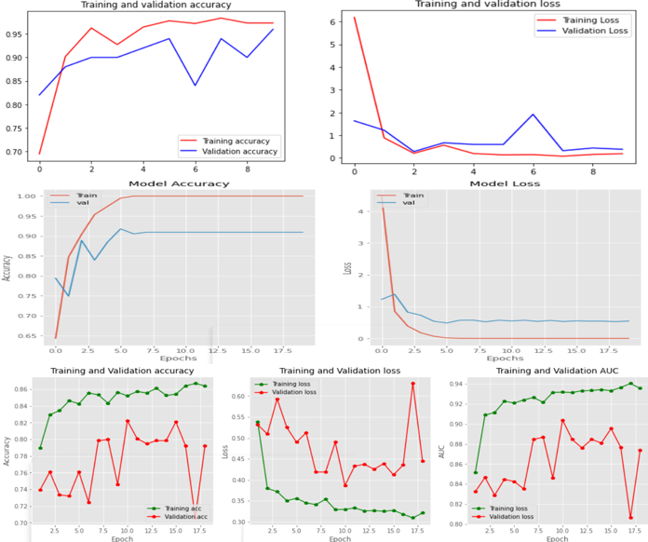
Training and Validation Graph For Normal VS Glaucoma
Upper One: Resnet50, Middle One: VGG19, Lower One: MobilenetV2

Slide 13
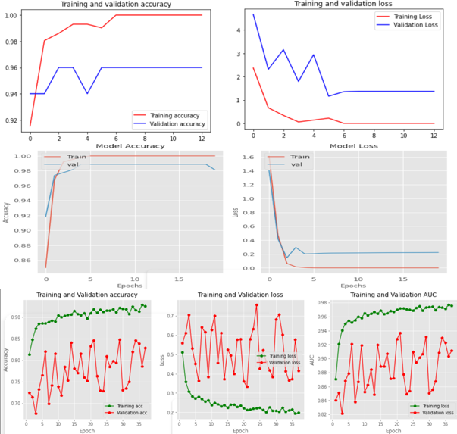
Training and Validation Graph For Normal VS Myopia
Upper One: Resnet50, Middle One: VGG19, Lower One: MobilenetV2

Slide 14
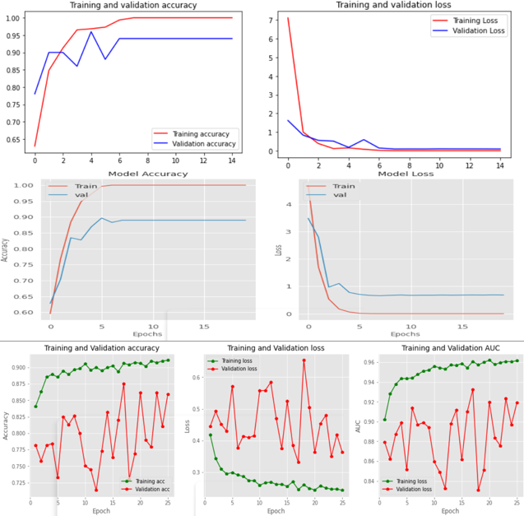
Training and Validation Graph For Normal VS Hypertensive
Upper One: Resnet50, Middle One: VGG19, Lower One: MobilenetV2

Slide 15
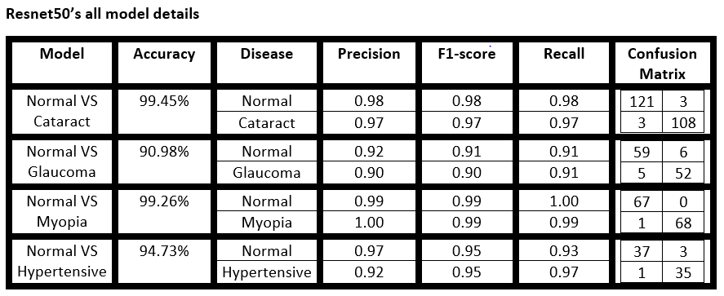
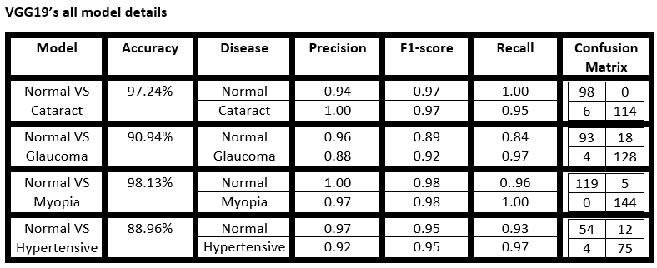
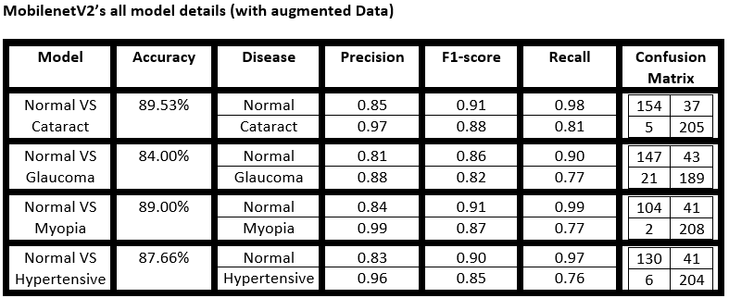
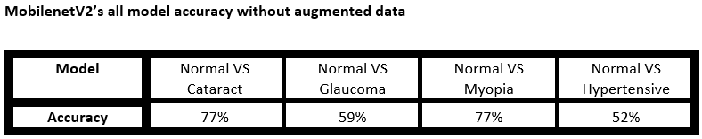
Model analysis Table

Slide 16
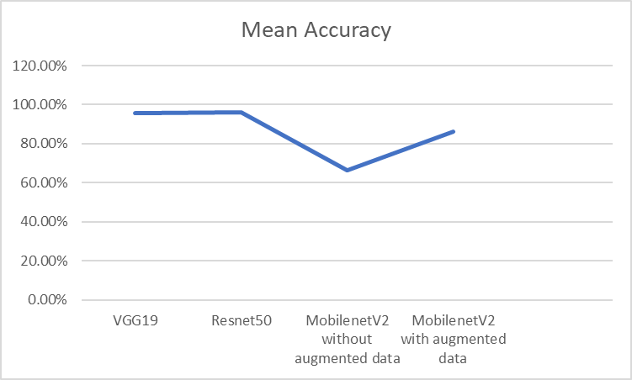
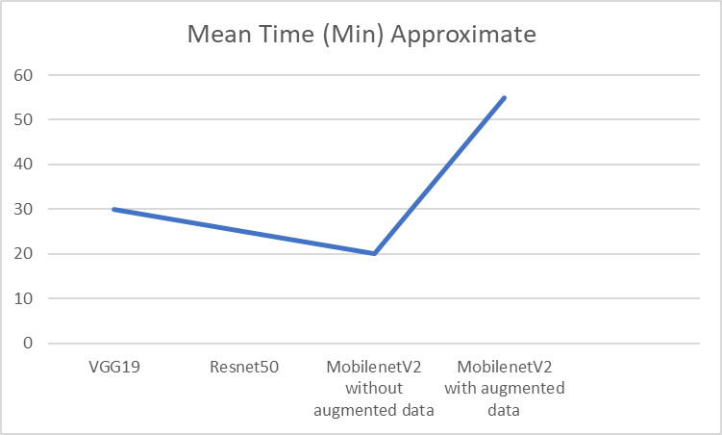
Model Comparison

Slide 17
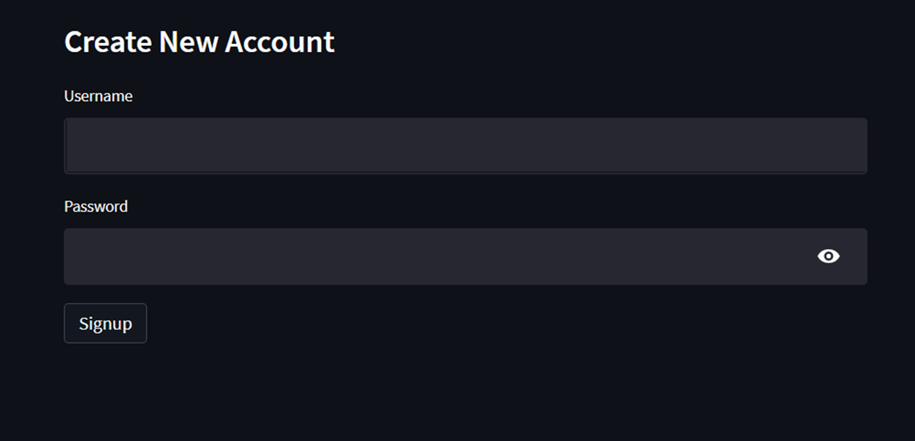
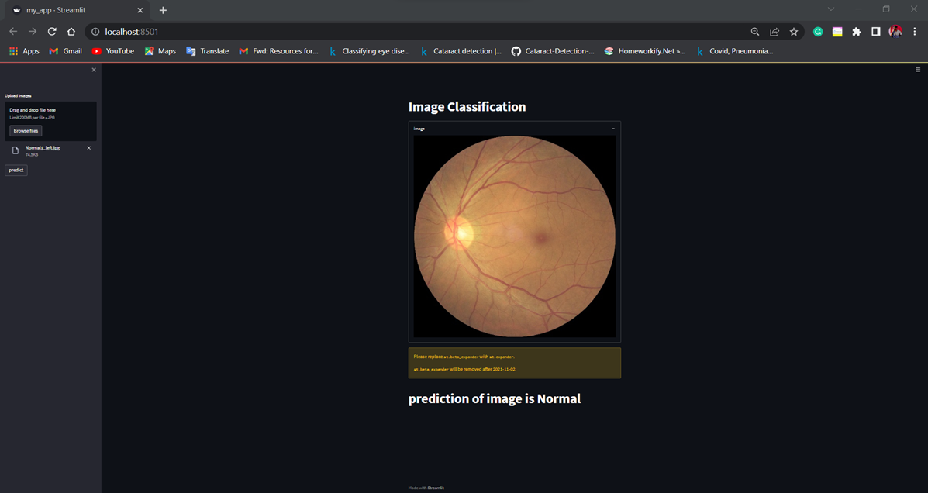
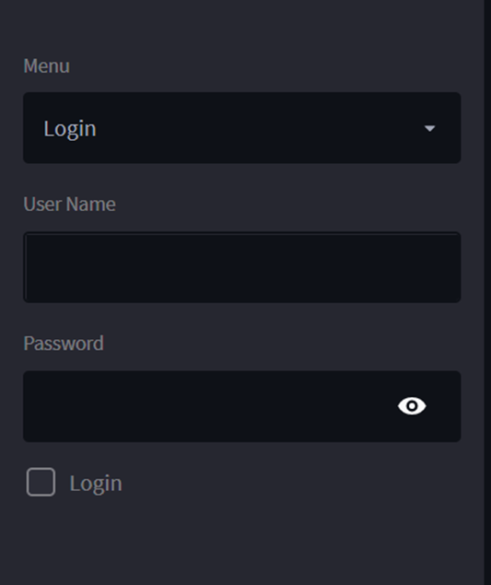
Deployment
*A Python-based open source app framework is called Streamlit .
*We used Streamlit to deploy our project.
*We use Sqlite3 for temporary Data Management.

Slide 18
Conclusion
We created four neural network-based models for classifying eye diseases. These models are VGG-19, Resnet-50, and MobileNetV2
We compared Normal vs cataract, Normal vs glaucoma, Normal vs hypertensive and Normal vs Pathological myopia.
The Resnet50 has the highest Accuracy And MobileNetV2 has no issue with hundred percent training accuracy
Furthermore, a user-friendly, real-time system for classifying ocular illnesses iscreated using the models reported in this paper

Slide 19
Reference
[1] M. S. Khan et al., “Deep learning for ocular disease recognition: An inner-class balance,” Comput. Intell. Neurosci., vol. 2022, p. 5007111, 2022.
[2] L. Jain, H. V. S. Murthy, C. Patel and D. Bansal, ”Retinal Eye Disease Detection Using Deep Learning,” 2018 Fourteenth International Conference on Information Processing (ICINPRO), 2018, pp. 1-6, doi: 10.1109/ICINPRO43533.2018.9096838
[3] N. M. Dipu, S. Alam Shohan, and K. M. A. Salam, “Ocular disease de- tection using advanced neural network based classification algorithms,” ASIAN JOURNAL OF CONVERGENCE IN TECHNOLOGY, vol. 7, no. 2, pp. 91–99, 2021.
[4]Nazir, T.; Irtaza, A.; Javed, A.; Malik, H.; Hussain, D.; Naqvi, R.A. Retinal Image Analysis for Diabetes-Based Eye Disease Detection Using Deep Learning. Appl. Sci. 2020, 10, 6185. https://doi.org/10.3390/app10186185

Slide 20
Reference
[5] Sarki, R., Ahmed, K., Wang, H. et al. Automated detection of mild and multi-class diabetic eye diseases using deep learning. Health Inf Sci Syst 8, 32 (2020). https://doi.org/10.1007/s13755-020-00125-5
[6] J. Shan and L. Li, "A Deep Learning Method for Microaneurysm Detection in Fundus Images," 2016 IEEE First International Conference on Connected Health: Applications, Systems and Engineering Technologies (CHASE), 2016, pp. 357-358, doi: 10.1109/CHASE.2016.12.
[3] N. M. Dipu, S. Alam Shohan, and K. M. A. Salam, “Ocular disease de- tection using advanced neural network based classification algorithms,” ASIAN JOURNAL OF CONVERGENCE IN TECHNOLOGY, vol. 7, no. 2, pp. 91–99, 2021.
[4]Nazir, T.; Irtaza, A.; Javed, A.; Malik, H.; Hussain, D.; Naqvi, R.A. Retinal Image Analysis for Diabetes-Based Eye Disease Detection Using Deep Learning. Appl. Sci. 2020, 10, 6185. https://doi.org/10.3390/app10186185

Slide 21
Thank You

